Slide 1
MCDA 5550 - Web App Development CH10-Angular JS Directives, Expressions, Controllers
Instructor: Dinesh kg

Slide 2
Overview
AngularJS is an open-source web application framework.
Developed in 2009.
Now maintained by Google.
Latest version is 1.2.21.

Slide 3
Angular Java Script
Widely used, Very powerful JavaScript Framework
Single Page Application (SPA) projects
Extends HTML DOM with additional attributes
More responsive to user actions
Licensed under the Apache license version 2.0

Slide 4
Prerequisites
Basic understanding of
HTML
CSS
JavaScript

Slide 5
Why Angular JS ?
HTML as template language
Data binding and Dependency injection eliminates lines of code
Executes the bundle within the browser
Exact match for any server technology
High-performance and easy to maintain

Slide 6
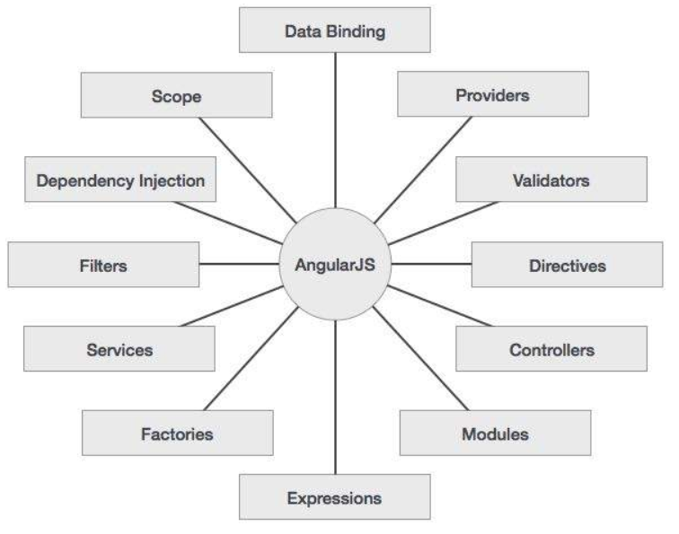
Concepts

Slide 7
Core Features
Data-binding − Automatic synchronization of data between model and view
Scope − Act as a glue between controller and view
Controller − JavaScript functions bound to a particular scope
Services − XMLHttpRequests. Singleton objects instantiated only once in app
Filters − Select a subset of items from an array and returns a new array

Slide 8
Cont’d…
Directives − Markers on DOM elements such as elements, attributes
AngularJS has built-in directives such as ngBind, ngModel, etc
Templates − Rendered view with information from the controller and model
single file (such as index.html) or multiple views in one page using partials(ngView)
Routing − Helps in switching views

Slide 9
Cont’d…
Model View Whatever − Unlike Model, View, and Controller
Closer to MVVM (Model-View-ViewModel)
Deep Linking − Encodes the state of application in the URL
Bookmarked and restored from the URL to the same state
Dependency Injection − Built-in dependency injection subsystem

Slide 10
Merits
Data binding capability to HTML gives user a rich and responsive experience
More functionality with short code.
Views are pure html pages, controllers written in JavaScript do the business processing.
Runs on all major browsers and smart phones/tablets.

Slide 11
Demerits
Not Secure − Server side authentication and authorization must to keep an application secure.
Not degradable − User disables JavaScript, then nothing would be visible, except the basic page.

Slide 12
AngularJS Structure
Framework Components
ng-app − Defines and links an AngularJS application to HTML.
ng-model − Binds the values of AngularJS application data to HTML input controls.
ng-bind − Binds the AngularJS application data to HTML tags.

Slide 13
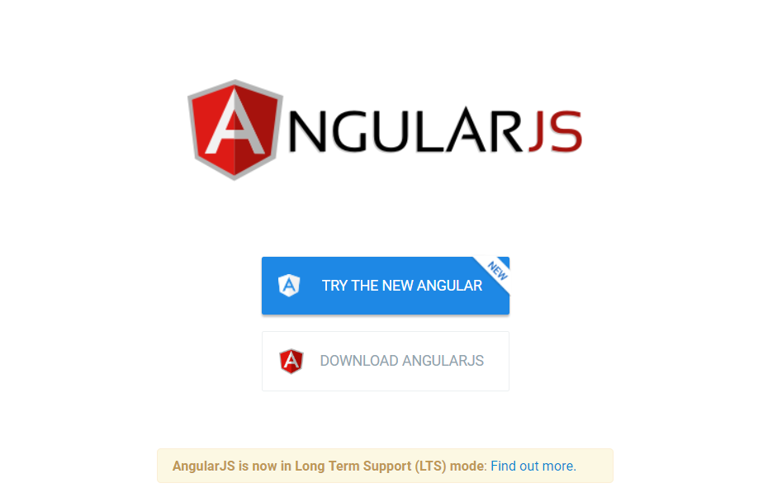
Environment Setup
Link to download: https://angularjs.org/

Slide 14
My first app
My First App
<!doctype html>
<html>
<head>
<script src = "https://ajax.googleapis.com/ajax/libs/angularjs/1.5.2/angular.min.js"></script>
</head>
<body ng-app = "myapp">
<div ng-controller = "WelcomeController" >
<h2>Welcome {{welcomeTo.title}}! MCDA5550 2019...</h2>
</div>
<script>
angular.module("myapp", [])
.controller("WelcomeController", function($scope) {
$scope.welcomeTo = {};
$scope.welcomeTo.title = "AngularJS";
});
</script>
</body>
</html>

Slide 15
Include
<head>
<script src = "https://ajax.googleapis.com/ajax/libs/angularjs/1.4.8/angular.min.js">
</script>
</head>
<body ng-app = "myapp">
</body>

Slide 16
View
<div ng-controller = "WelcomeController" >
<h2>Welcome {{welcomeTo.title}}! MCDA5550 2019...</h2>
</div>
ng-controller tells AngularJS which controller to use with this view.
welcomeTo.title tells app to write the model value in HTML.

Slide 17
Controller
<script>
angular.module("myapp", [])
.controller("WelcomeController", function($scope) {
$scope.welcomeTo = {};
$scope.welcomeTo.title = "AngularJS";
});
</script>
WelcomeController function in the angular module named myapp
Controller function is registered using angular.module(...).controller(...) function call
$scope parameter model is passed to the controller function

Slide 18
Directives
ng-app − Starts an angular application
ng-init − Initializes application data
ng-model − Defines the model that is variable to be used in App
ng-repeat − Repeats HTML elements for each item in a collection

Slide 19
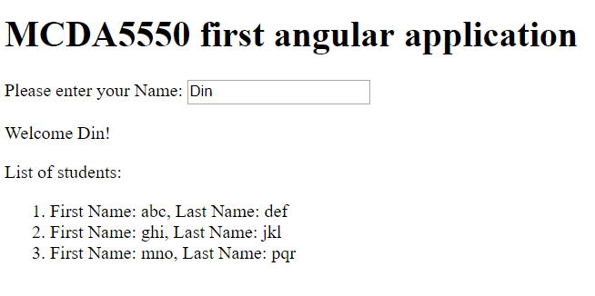
Cont’d…
<!doctype html>
<html>
<head>
<title>MCDA5550 2019</title>
</head>
<body>
<h1>MCDA5550 first angular application</h1>
<div ng-app = "" ng-init = "students = [{firstname:'abc',lastname:'def'},
{firstname:'ghi',lastname:'jkl'}, {firstname:'mno',lastname:'pqr'}]">
<p>Please enter your Name: <input type = "text" ng-model = "name"></p>
<p>Welcome <span ng-bind = "name"></span>!</p>
<p>List of students:</p>
<ol>
<li ng-repeat = "student in students">
{{ 'First Name: ' + student.firstname + ', Last Name: ' + student.lastname }}
</li>
</ol>
</div>
<script src = "https://ajax.googleapis.com/ajax/libs/angularjs/1.3.14/angular.min.js">
</script>
</body>
</html>

Slide 20
Expressions
Using numbers
<p>Total amount: {{materialprice * quantity}} CAD</p>
Using Strings
<p>Hello {{student.firstname + " " + student.lastname}}!</p>
Using Object
<p>Student Id: {{student.Id}}</p>
Using Array
<p>Grades(Science): {{grades[3]}}</p>

Slide 21
Controllers
<div ng-app = "" ng-controller = "studentController">
...
</div>
<script>
function studentController($scope) {
$scope.student = {
firstname: “Dinesh",
lastname: “KG",
fullname: function() {
var studentObject;
studentObject = $scope.student;
return studentObject.firstname + " " + studentObject.lastname;
}
};
}
</script>

Slide 22
Filters
uppercase - converts a text to upper case text.
Name in Upper Case: {{student.fullname() | uppercase}}
lowercase - converts a text to lower case text.
Name in Lower Case: {{student.fullname() | lowercase}}
currency - formats text in a currency format.
fees: {{student.fees | currency}}

Slide 23
Cont’d…
filter - filter the array(subset)based on provided criteria.
Enter the Course: <input type = "text" ng-model = “courseName"> Course: <ul> <li ng-repeat = “course in student.courses | filter: courseName"> {{ course.name + ‘, grades:’ + Course.grades }} </li> </ul>
orderby - orders the array based on provided criteria.
Course: <ul> <li ng-repeat = "course in student.courses | orderBy:’grades’”> {{ course.name + ‘, grades:’ + course.grades }} </li> </ul>

Slide 24
Tables
Table data is generally repeatable.
The ng-repeat directive can be used to draw table easily
<table border = "0">
<tr>
<td>Enter first name:</td>
<td><input type = "text" ng-model = "student.firstname"></td>
</tr>
<tr>
<td>Enter last name: </td>
<td>
<input type = "text" ng-model = "student.lastname">
</td>
</tr>
</table>
<tr ng-repeat = “course in student.courses">
<td>{{ course.name }}</td>
<td>{{ course.grades }}</td>
</tr>

Slide 25
HTML DOM Elements
ng-disabled - disables a given control
ng-show - shows a given control
ng-hide - hides a given control
ng-click - represents a click event
<tr>
<td><input type = "checkbox" ng-model = "enableDisableButton">Disable Button</td>
<td><button ng-disabled = "enableDisableButton">Click Me!</button></td>
</tr>

Slide 26
Apps powered by Angular JS
YouTube for PS3
Grasshopper
Google Marketing Platform (even other apps like family, digital etc …)
Xbox
Netflix
PayPal
The Guardian

Slide 27
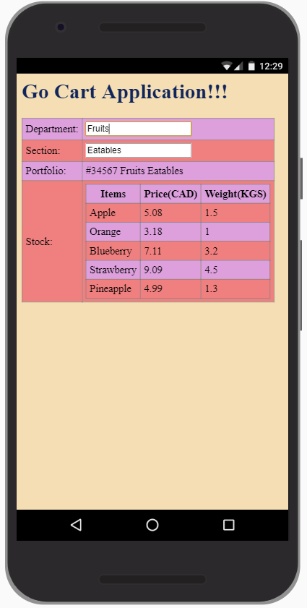
Activity
Create this Angular JS app
Place the project on the server!

